Slide 1
Code Geeks Team
Project 5 :maintenance & store app

Slide 2
Table of contents
01
02
03
04
05
About Team
Describe the project
Tour around the project
How we applied what we have learned
Stretch Goals

Slide 3
My Quote!
Your work is going to fill a large part of your life, and the only way to be truly satisfied is to do what you believe is great work. And the only way to do great work is to love what you do. If you haven't found it yet, keep looking. Don't settle.

Slide 4
01
About Team

Slide 5
Mohammad Alabed
Full Stack Web Developer
studied civil engineering and graduated from it, and now I am learning programming because I consider it part of my identity

Slide 6
Qtada Alblwi
Full Stack Web Developer
A civil Engineering graduated in 2021

Slide 7
Abdullah Aljamal
Full Stack Web Developer
A Networks and Information Security Engineering Student
a passionate and dedicated full stack web developer. With a strong foundation in both front-end and back-end technologies

Slide 8
Describe the project

Slide 9
You can divide the content
Products Store
CraftMen Services
Product means any deliverable under the Contract, which may include commodities, services. Retail outlet means any establishment at which consumer products are sold, supplied, or offered for sale directly to consumers.
Craftsman services provided on a website encompass a wide range of skilled trades and artisan offerings, tailored to meet diverse needs. From carpentry, plumbing, and electrical work to painting, landscaping, and custom woodworking, these services are designed to bring craftsmanship and expertise to home improvement, repair, and design projects.

Slide 10
Packages used in the project

Slide 11
Packages used in the project
Server Side
express
Express.js is a popular web application framework for Node.js. It simplifies the process of building robust and scalable web applications and APIs
mongoose
jsonwebtoken
is an Object Data Modeling (ODM) library for MongoDB and Node.js. It provides an abstraction layer over MongoDB, making it easier to work with MongoDB databases by defining schemas and models for data.
JWTs are used for secure authentication and data exchange between parties in a compact and self-contained way
postgressql
bcryptjs
is a library used for hashing and salting passwords. It's essential for securely storing passwords in databases. a one-way hashing algorithm

Slide 12
Packages used in the project
client side
cloudinary
Cloudinary is a cloud-based image and video management service. It offers features like image and video upload, storage
moment
axios
is a JavaScript library for parsing, formatting, and manipulating dates and times.
Axios is a popular JavaScript library for making HTTP requests from the browser or Node.js. It provides a simple and elegant way to send asynchronous HTTP requests, handle responses,
react-router-dom
bootstrap
is a package commonly used in React applications for handling client-side routing. It allows you to create single-page applications (SPAs) by defining routes and rendering components based on the URL
Bootstrap is a widely used front-end framework for building responsive and visually appealing web interfaces. It includes a collection of CSS and JavaScript components,

Slide 13
Tour around the project

Slide 14
Project stages
Then draw Diagram and WireFrame using mokups
Create databases, use PostgreSQL, MongoDB, and start experimenting with Postman
Nodejs
React.js
Trillo
Mokups
Date Base
First, we arranged and organized the work using Trillo to identify the stages of the workflow
Server build and Schema build and Tables and Controllers
Finally, we used react.js to build user interfaces and send requests to the server

Slide 15
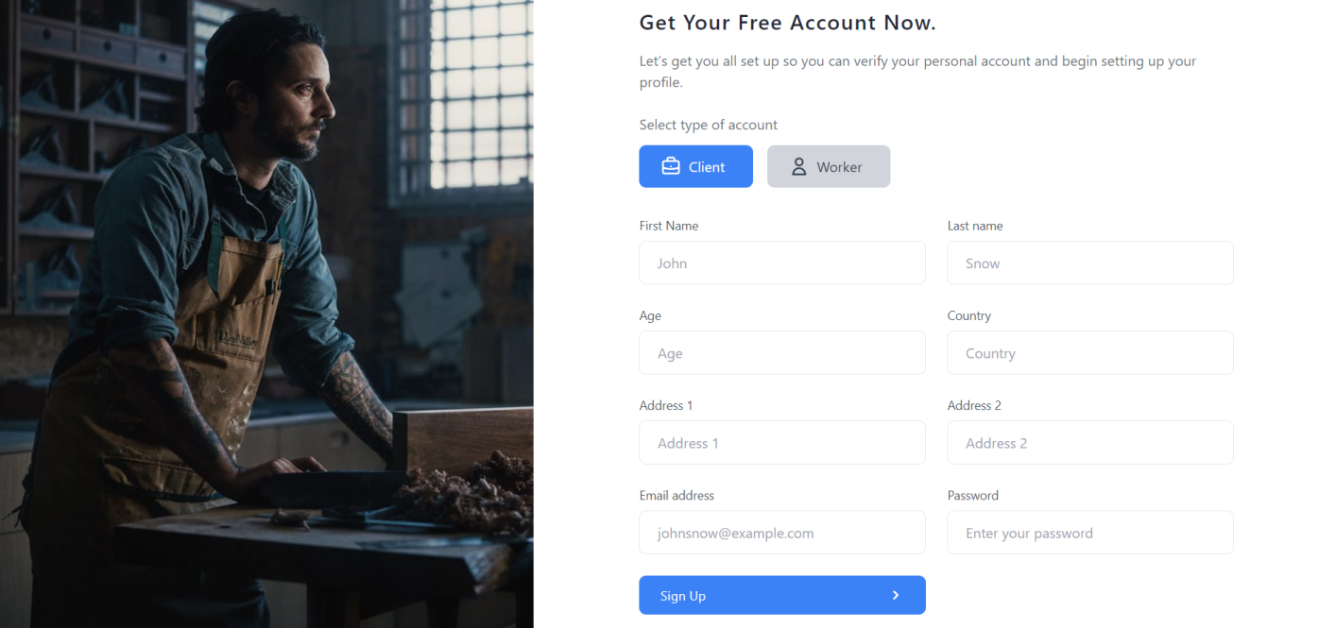
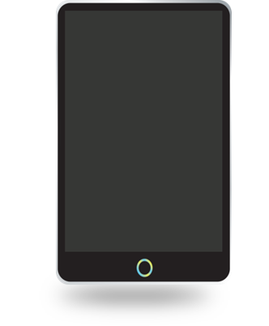
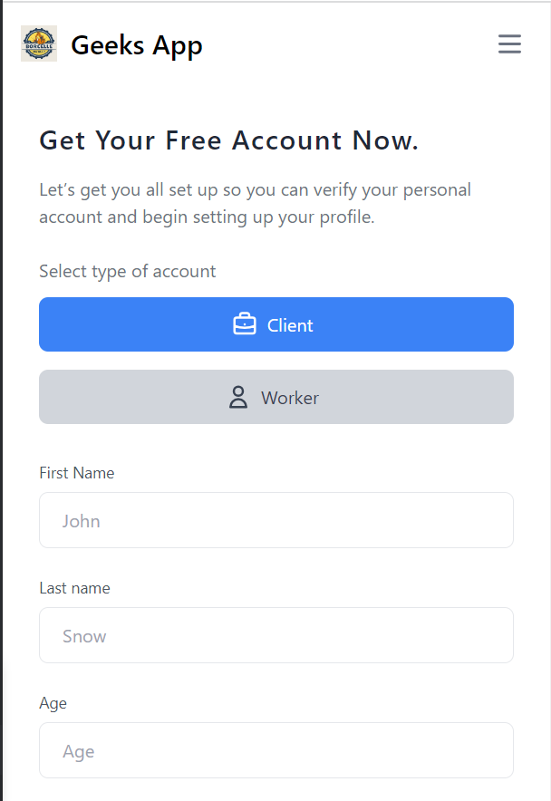
Sign Up Page
To be able to access the site, you must register an account. You can easily register an account by adding some personal data such as name, age, username, email, and password.
It should be noted that the username must be unique, and the email must be real in order for you to receive the activation message.
When you register an account with a unique email, you will receive an activation message on your email

Slide 16
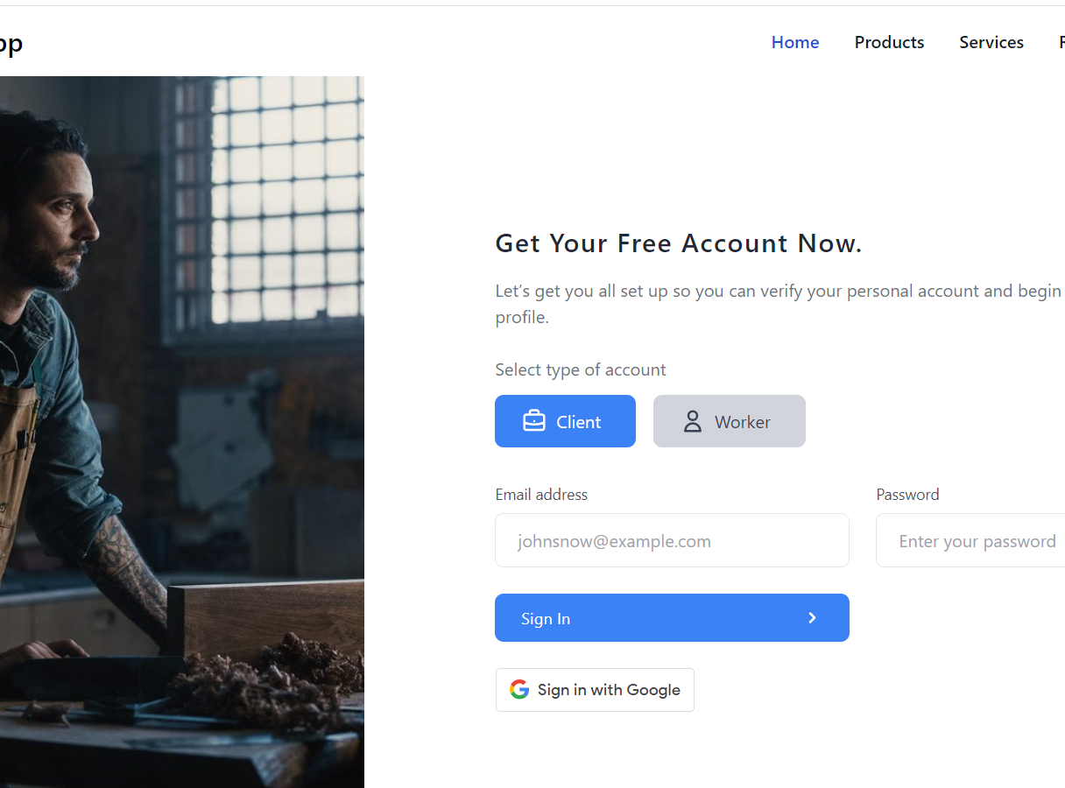
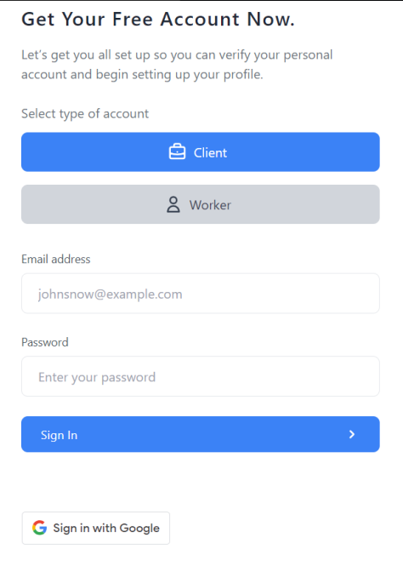
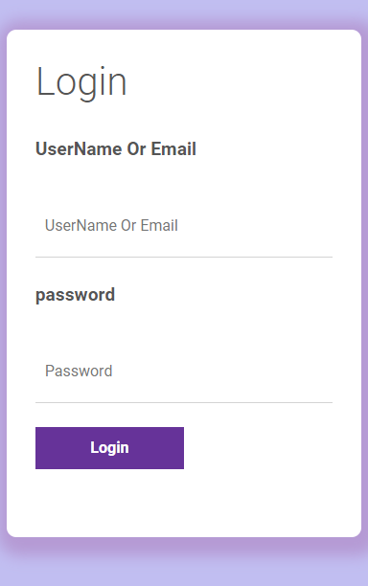
Sign In Page
To be able to access the site, you must Login to your account. You can log in to the site via email or username and password, but you must verify that the email is activated from the confirmation message that arrived.
And You Loging With google Directly

Slide 17
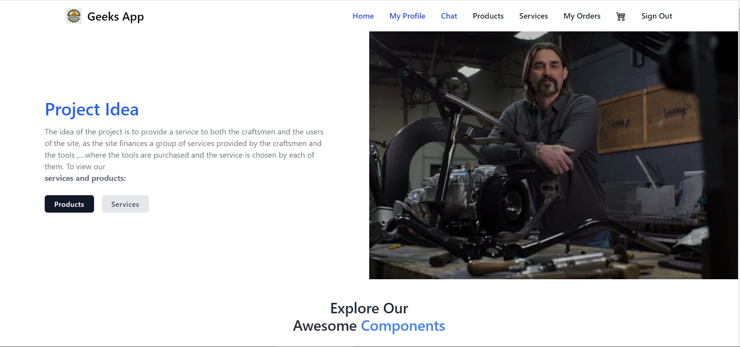
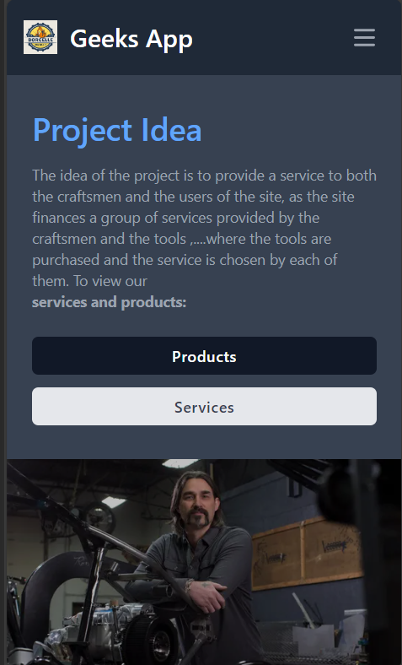
HomePage
This is The Home Page. Here You can Find More about Site

Slide 18
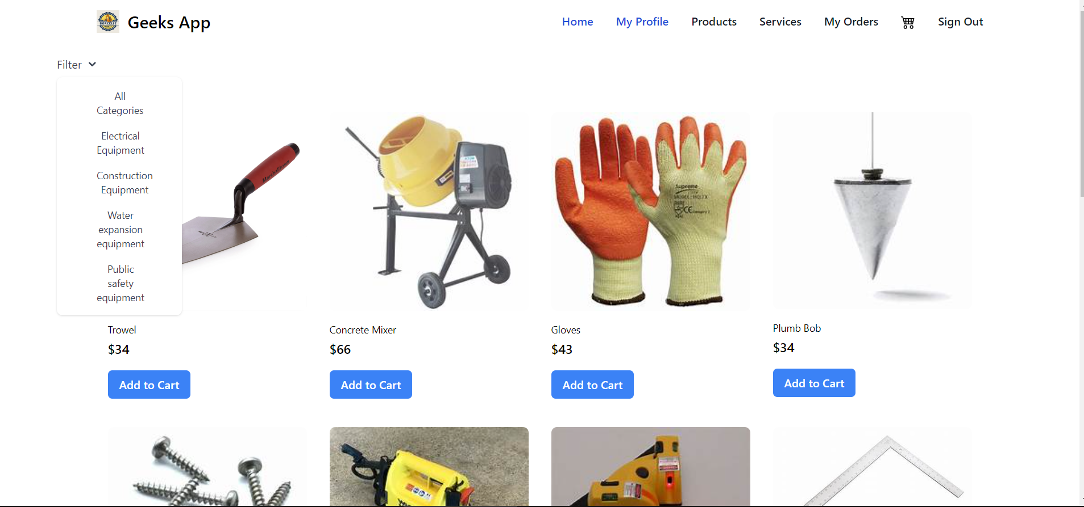
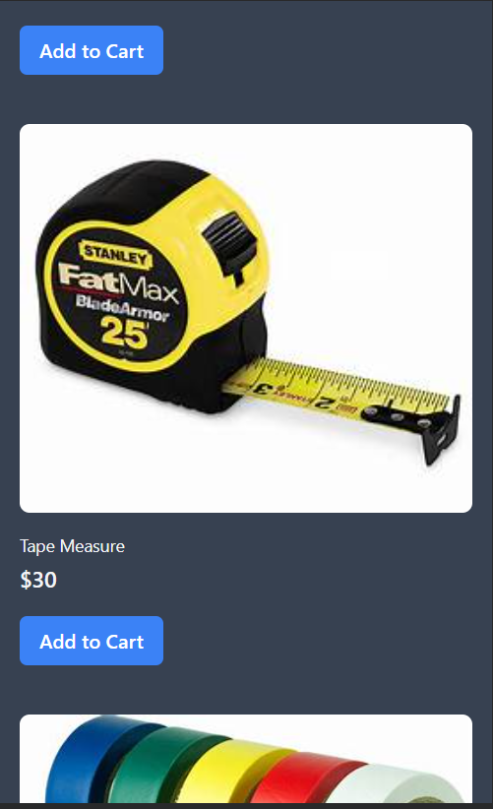
Products Page
This is The Products Page. Here you can view All products and added any of them in the basket
The Lowest Price In the Region. 😂😂

Slide 19
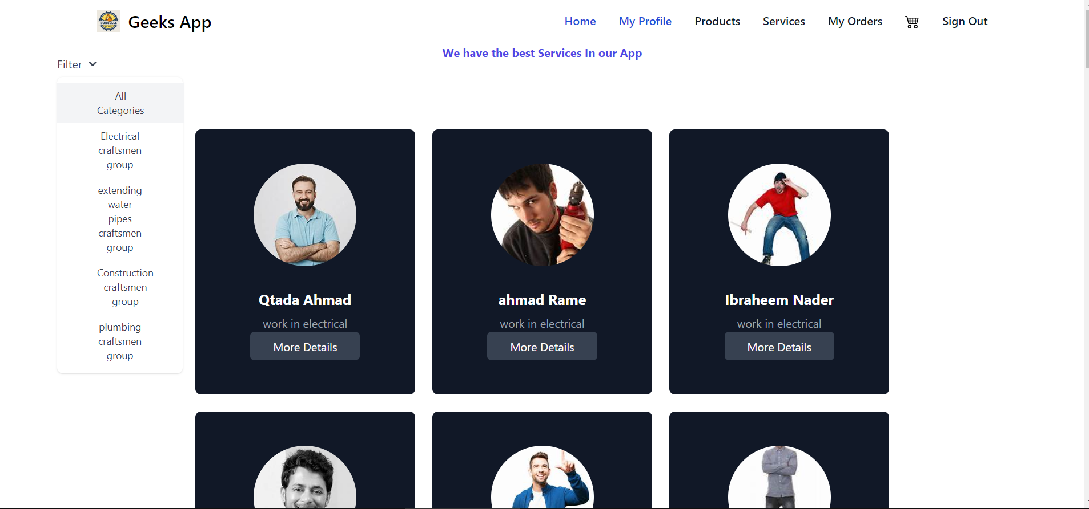
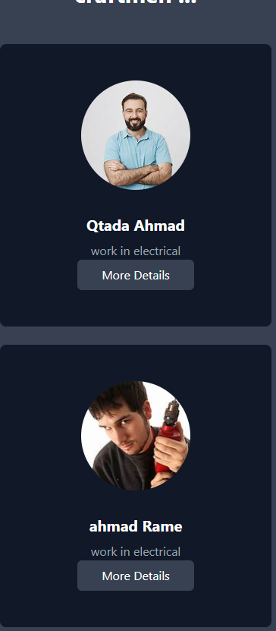
Services Page
This is The Services Page. Here you can view all Employees register in the site

Slide 20
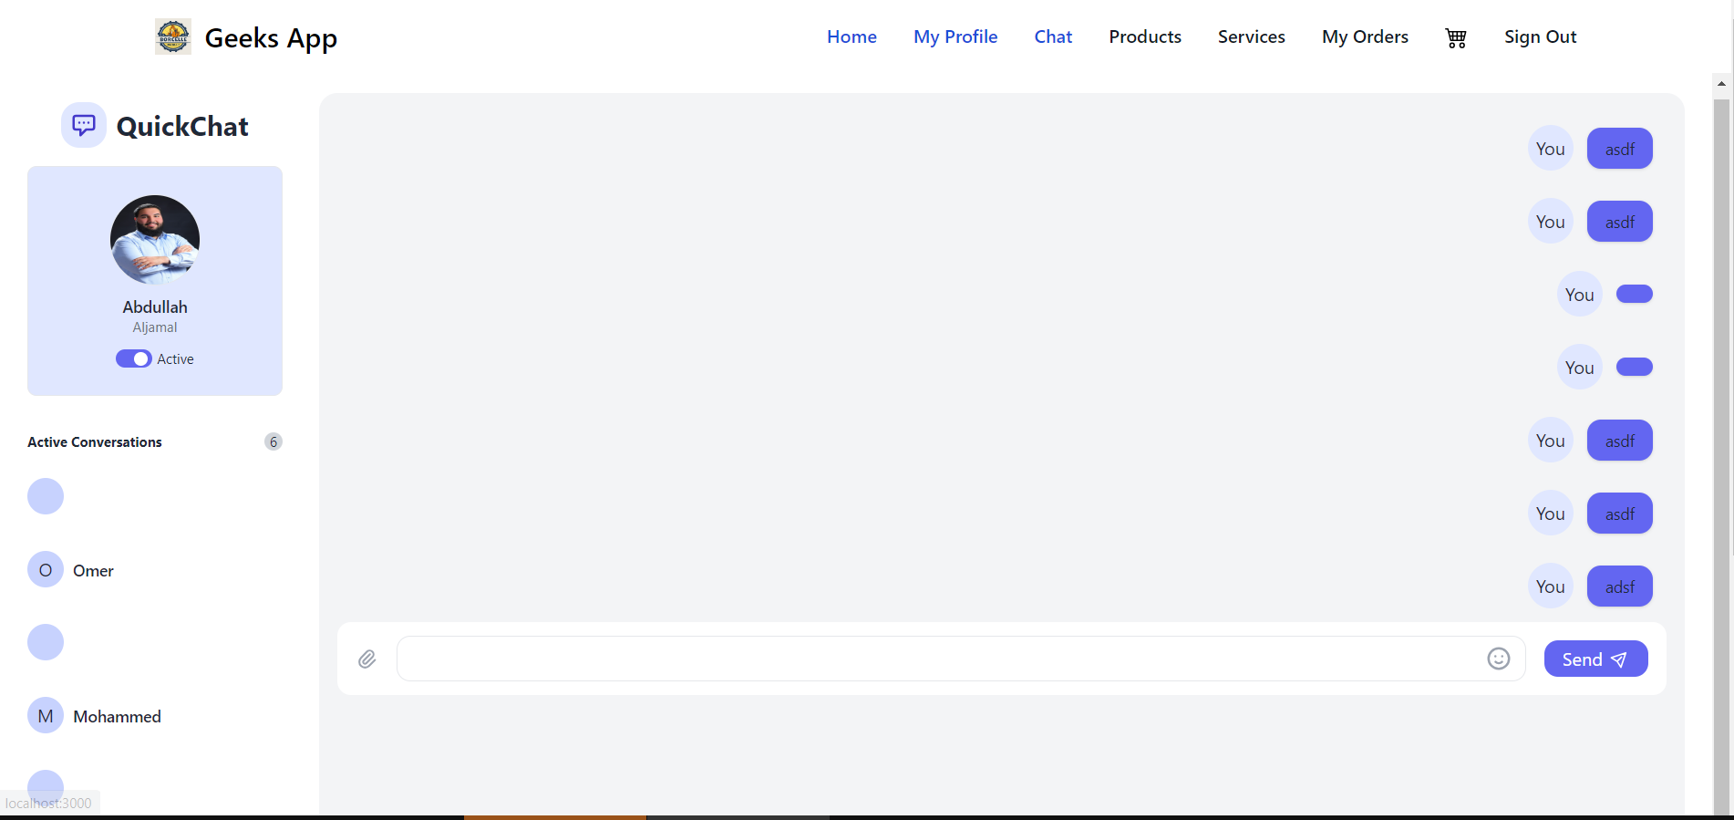
Chat Page
This is The Cha Page. Here you can chat with the craft man you chose for your home

Slide 21
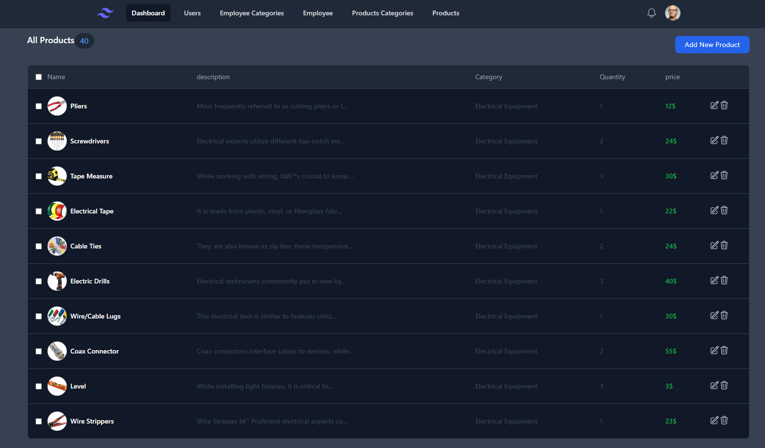
Admin Page
This is The Admin Page. Here you can view everything in the site you can add edit and delete

Slide 22
How We applied what We have learned
Using Multi Databsase
01
Relations between tables
02
Using Socket.Io
03
Scalability and performance
04
Tailwind CSS
05

Slide 23
Stretch Goals
Make the Project Real Project
01
Improving responsiveness
02
Improve The performance of the site
03
Admin Dynamic And Real time graph
04
Improving automation functionalities
05

Slide 24
-Team Member
اختر ألمك فلا بد في الدنيا من ألم

Slide 25
Special thanks
ANAS
ASMA
SAWALMEH
WALA’A
KHALID
CLASS CORDINATER
JOUZA
AND ALL THE TEAM

Slide 26
Thanks!
Do you have any questions?
codegeeks@geeks.com
+79 xxxxxxx
http://localhost:3000/

